Slide 1
MANHATTAN COMMUNITY BOARD 1
Waterfront, Parks & Cultural Committee • July 21, 2026
When a “correction”
creates new errors
The textual changes to the Al Qalam historical sign and a fair process for repairing them
Todd Fine, Ph.D.
Historian and initiator of the Al Qalam monument project
Photo: NYC Parks / Daniel Avila

Slide 2
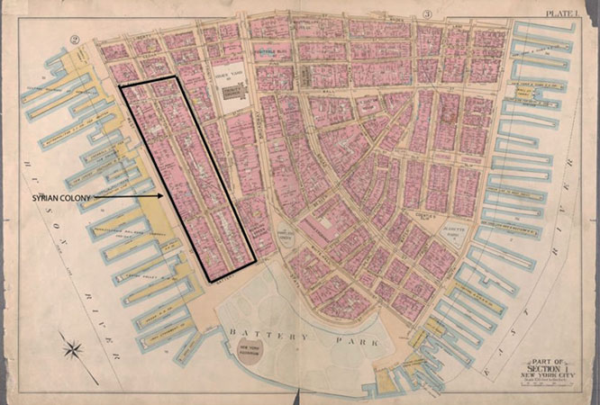
The monument needs a durable historical text
Al Qalam is a major civic achievement: a permanent work honoring New York's first Arabic-speaking literary community.
The original sign wording was not perfect. Unqualified and minimally-explained uses of “Greater Syria” and “Syrian” can sound provocative or misleading to present-day readers.
But a correction should add context, not replace one simplification with another.
Sources: NYC Parks, Apr. 30, 2026; 1899 map reproduced by The Broadsheet, Oct. 4, 2019.
2

Slide 3
Celebration became removal in three weeks
APR 30
EARLY MAY
MAY 14
MAY 17–18
MAY 20
Installed:
Original sign unveiled with the artwork.
Pushback:
Lebanese cultural and diaspora objections spread publicly.
Culture Minister
Ghassan Salamé asks for diplomatic action and revised or supplemental text.
Petition + Foreign Ministry:
Petition seeks clarification; diplomats are directed to intervene.
Concession:
Lebanese Foreign Minister Raggi announces willingness for removal and replacement.
The controversy moved faster than a normal public-history review.
Sources: NYC Parks (Apr. 30); Lebanese Culture Ministry letter (May 14); Change.org (May 17); The National (May 18); Raggi statement (May 20).
3

Slide 4
Replacement appeared without public review
Sign removed
Text rewritten privately
Replacement installed
The original plaque came down after diplomatic and public pressure.
No draft was published, no source memorandum was released, and no public comment period was offered.
A substantially different text appeared as a finished product.
MAY 20
LATE MAY–JUNE
EARLY JULY
Sources: public chronology; revised sign observed at the beginning of July; exact comparison prepared July 5, 2026.
4

Slide 5
The revision went beyond Lebanon's request
The May 14 letter and May 18 Foreign Ministry directive sought recognition of Lebanese origins. That concern could have been addressed by adding dates, birthplaces, and an explanation of geographic terminology.
WHAT THE MAY 14 LETTER REQUESTED
WHAT THE REPLACEMENT ALSO DID
• Correct or supplement the interpretive text
• Identify Lebanese roots of named writers
• Use “Lebanese-American” language
• Include Lebanese cultural participation
• Removed five uses of “Syrian”
• Changed “1,200 Syrians” to “1,200 immigrants”
• Turned “a Syrian school” into “a school”
• Sorted all nine writers into modern countries
A legitimate request for recognition became a broader rewrite of the neighborhood's history.
Sources: Ghassan Salamé to Youssef Raggi, May 14, 2026; Youssef Raggi Foreign Ministry directive, May 18; public statement, May 20; Al Qalam Sign Text Diff.
5

Slide 6
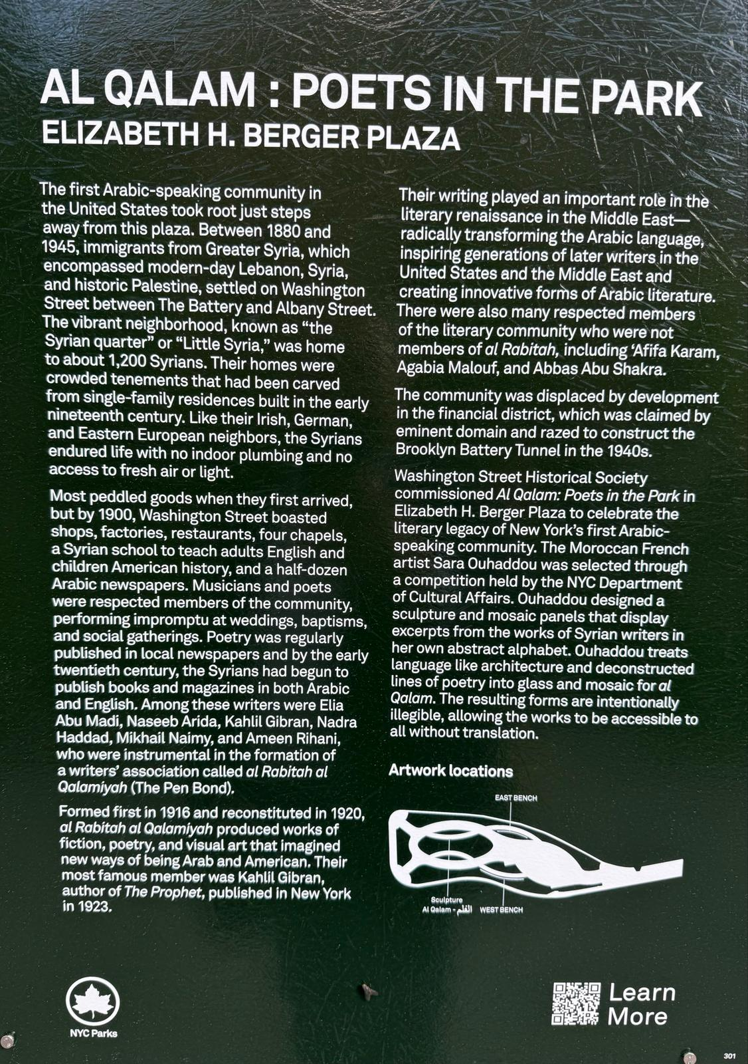
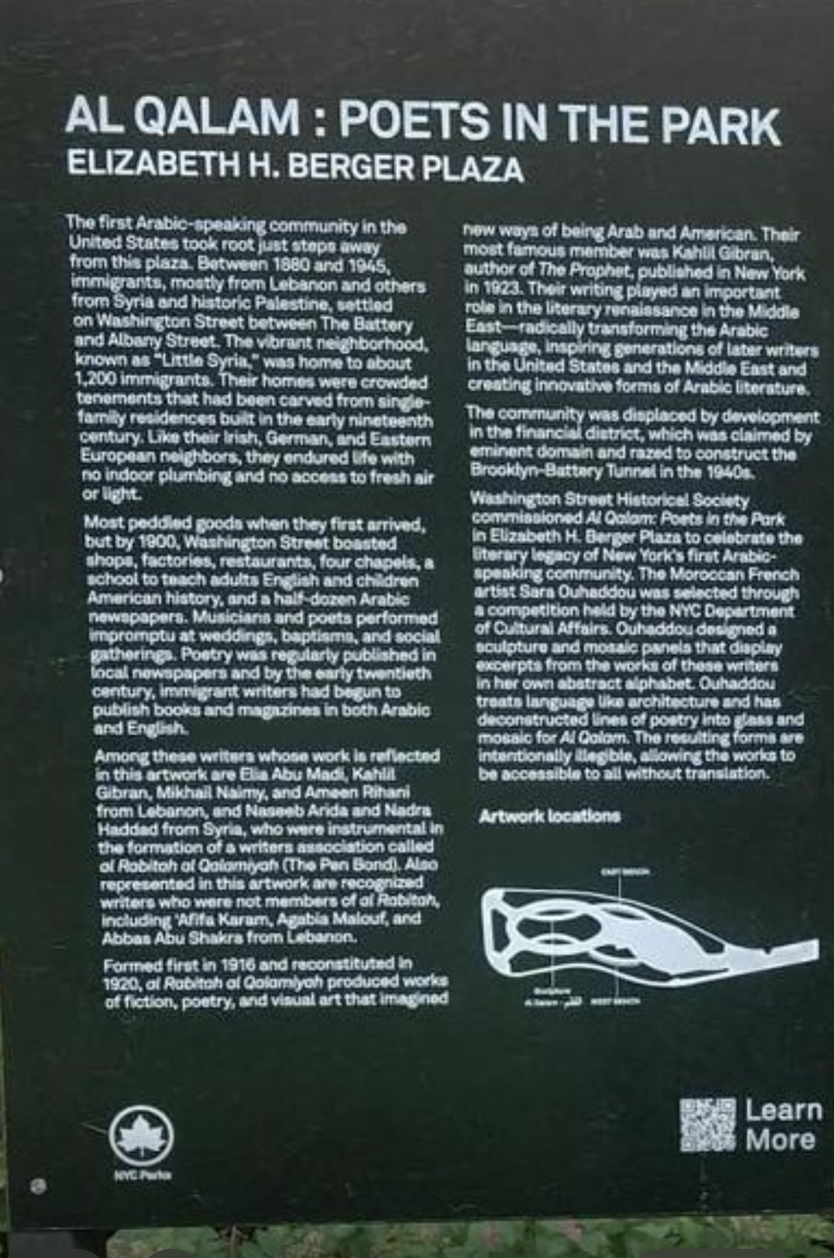
The revision changed the plaque's logic
ORIGINAL
REVISED
5
uses of “Syrian” removed
9
writers assigned identity to modern countries, in a manner they would have possibly objected to
Source: original and revised sign photographs and transcript at washingtonstreet.group/al-qalam-sign-diff/ (prepared July 5, 2026).
6

Slide 7
The new origin sentence is awkward and unframed
ORIGINAL: "immigrants from Greater Syria, which encompassed modern-day Lebanon, Syria, and historic Palestine"
REVISED: "immigrants, mostly from Lebanon and others from Syria and historic Palestine"
1 Grammar
2 Categories
3 Time
“mostly from Lebanon and others from…” is a nonparallel and grammatically weak construction.
Lebanon and Syria are modern states; “historic Palestine” is a historical geography. The list does not compare like with like.
The sentence never says “areas that are now…” Visitors are left to project today's borders backward onto 1880. No context to understand WHY the neighborhood was called “Little Syria.”
The revision removed a controversial historical explanation without replacing it.
Source: Al Qalam Sign Text Diff, paragraph 1; analysis of the revised sentence's grammar and historical categories.
7

Slide 8
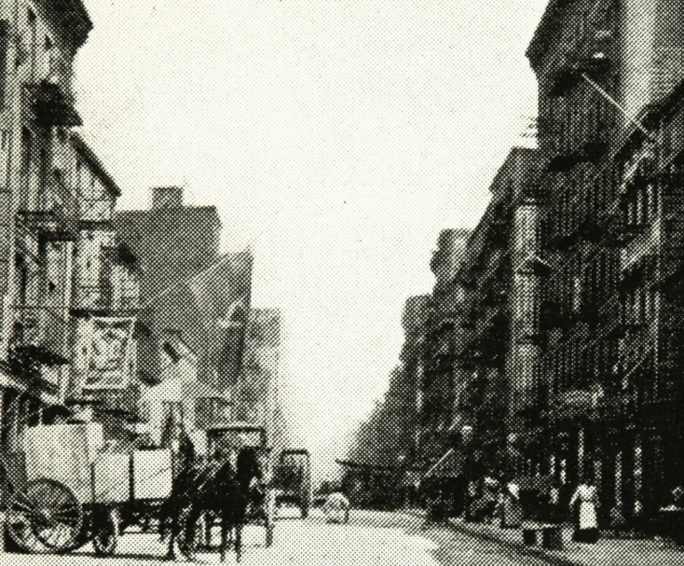
The revision now misuses the 1,200 figure
1,200
The historical claim is specific:
“The vibrant neighborhood, known as “Little Syria,” was home to about 1,200 immigrants.”
The revised sign turns that year-specific estimate by Linda Jacobs related to 1900 for one ethnic community into an apparent total for all immigrants, of all nationalities, across 1880–1945.
The surrounding Lower West Side also included Irish, German, Greek, Slavic, Scandinavian, Eastern European, and other residents. “1,200 immigrants” erases that larger population rather than recognizing it.
Sources: Linda K. Jacobs, The New Arab, Apr. 21, 2023; NYPL, Nov. 19, 2015; KalimahPress, Sept. 22, 2016; photo via Tenement Museum.
8

Slide 9
Deleting “Syrian” erased institutional history
ORIGINAL | REVISED | WHAT IS LOST
“the Syrian quarter” or “Little Syria” | “Little Syria” | The sign keeps the nickname but removes the term that Linda Jacobs and others have argued was also common.
“a Syrian school” | “a school” | Linda Jacobs had documented how the school was created by the Syrian Society, founded in 1892 by Ameen F. Haddad, at 95 Washington Street.
Historical names are evidence. Removing them does not make the text neutral; it makes the institutions and the history harder to understand.
Sources: Al Qalam Sign Text Diff; Linda K. Jacobs, The New Arab, Apr. 21, 2023; NYPL, Nov. 19, 2015.
9

Slide 10
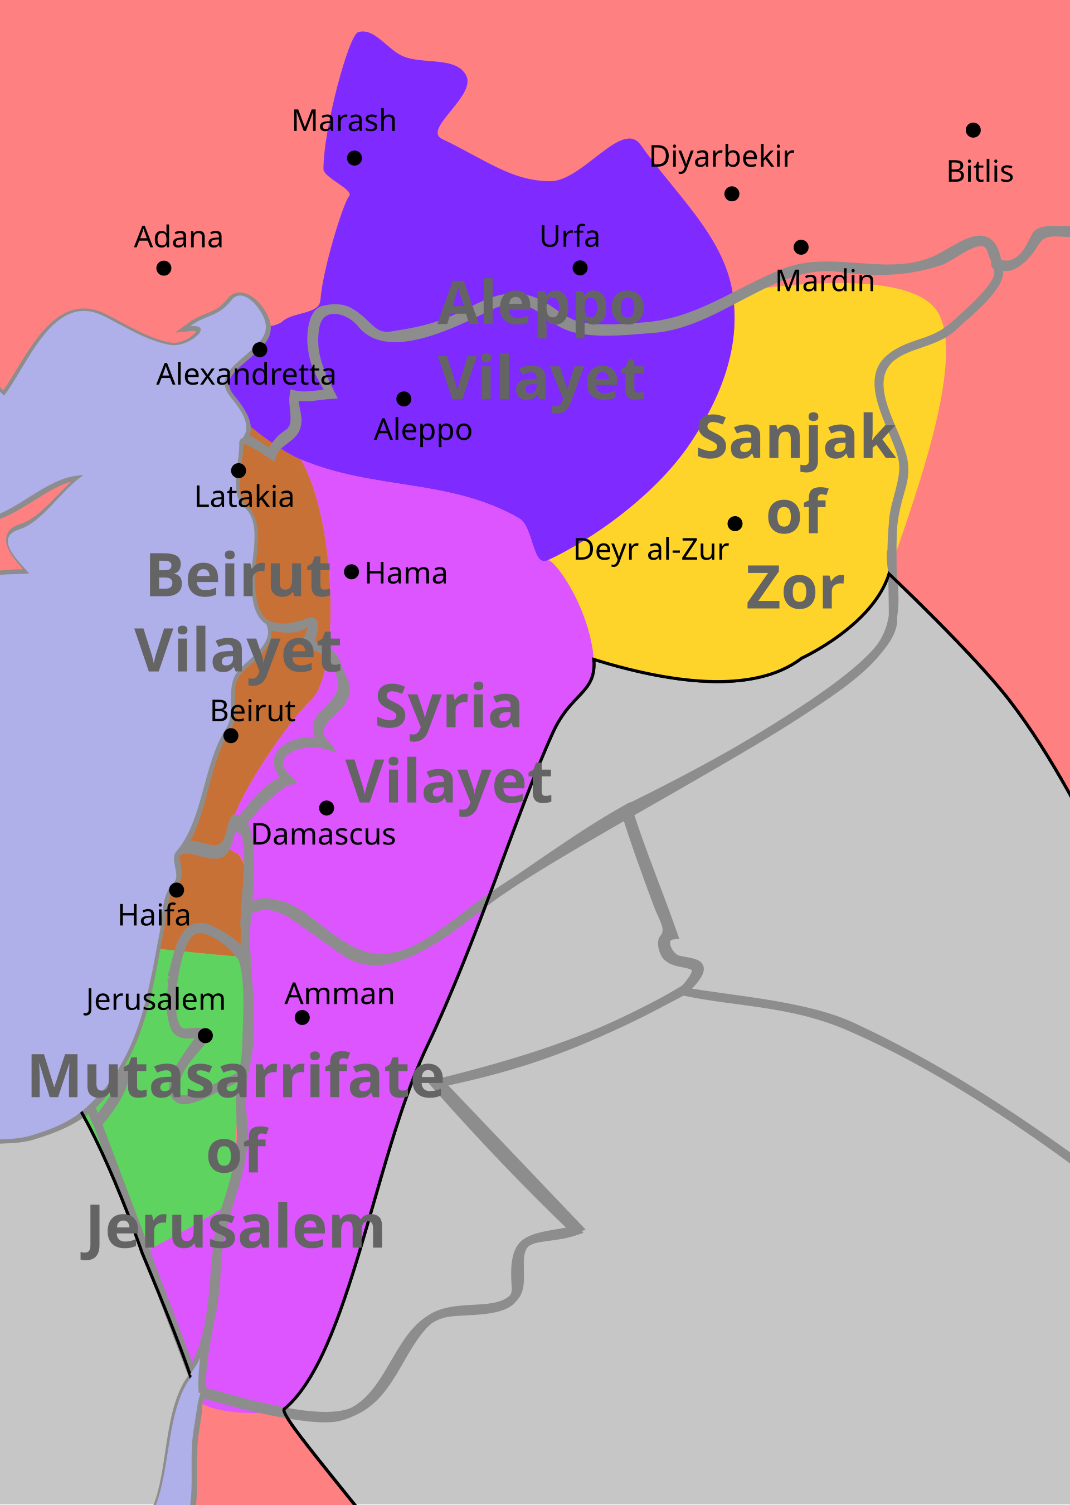
Modern labels need dates and context
The immigrants arrived before today's national borders existed.
• “Syrian” could function as a broad regional or communal label in the United States. The term “Lebanese” did not exist until much later.
• Mount Lebanon, Beirut, Damascus, Homs, and Jerusalem belonged to different Ottoman administrative units, but people flowed between them with overlapping identities.
• Modern Lebanese, Syrian, and Palestinian identities developed through and after these transitions.
The plaque may name present-day countries but should say “in what is now…” and also explain the context that produced the label “Little Syria.”
Ottoman administrative geography, 1900
Map: “Ottoman Syria 1900,” Wikimedia Commons, CC BY-SA 3.0. Sources: The National, May 18, 2026; New Lines, May 22, 2026.
10

Slide 11
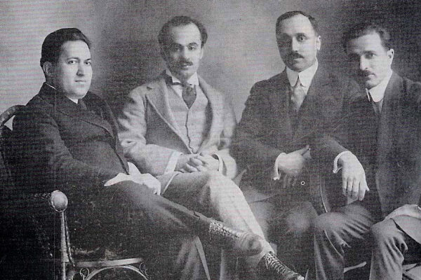
A missing co-founder is now more conspicuous
The sign says the Pen League was “formed first in 1916,” but omits one of the two men responsible for that first formation.
Abd al-Masih Haddad
• Co-founded the first Pen League with Nasib Arida
• Published As-Sayeh, a principal forum for Mahjar writers
• Participated in the reconstituted 1920 league
• Is not named on the sign or the monument, while his brother Nadra, also from Homs, is
• New phrasing creates even more confusion: “and Naseeb Arida and Nadra Haddad from Syria, who were instrumental in the formation of a writers’ association called al Rabitah al Qalamiyah”
Nasib Arida • Kahlil Gibran • Abd al-Masih Haddad • Mikhail Naimy
Once the revised sign sorts the writers by country, this Homs-born co-founder's absence becomes even harder to justify.
Sources: Arab American National Museum digital collection; Al-Funun, “The Pen Bond: 1916, 1920–1931”; Afikra, July 15, 2023.
11

Slide 12
The revised text fails on three levels
01
02
03
DEMOGRAPHY
HISTORICAL CONTEXT
PUBLIC PROCESS
“1,200 Syrians” becomes “1,200 immigrants,” misusing a 1900 group estimate as the neighborhood's total. The sentence also flattens the Lower West Side's wider diversity.
Modern country labels are projected backward without borders, dates, or context. Historical institutions lose their names; writers are attached to present-day countries; and the first Pen League's co-founder is even more obscured.
The replacement was drafted after diplomatic pressure, without a published draft, source memo, neutral review panel, or public comment period.
These are repairable errors if the process is reopened.
Synthesis of the documented textual changes and historical evidence presented in slides 6–11.
12

Slide 13
A neutral committee can repair the record
Create a small, independent group with no single institution or national constituency controlling the wording.
1 CONVENE
2 DOCUMENT
3 DRAFT
4 REVIEW
Historians of Ottoman Levant, Arab American migration, New York immigration, and Mahjar literature, with Lebanese, Syrian, and Palestinian expertise.
Publish the sources behind every demographic number, institutional name, and writer attribution.
Write for uninformed and non-invested visitors: distinguish period labels from present-day countries, and use “what is now” where needed.
Release the draft publicly, working with the Parks Department, and return to CB1 before fabrication.
The goal is not a compromise among governments. It is an accurate explanation for visitors and for New Yorkers.
Recommendation for a transparent public-history process; proposed structure for discussion by CB1 and NYC Parks.
13

Slide 14
Requested action from Community Board 1
ASK NYC PARKS AND PARTNER AGENCIES TO:
1
Treat the July 2026 wording as an interim replacement, not as the final historical interpretation.
2
Convene an independent scholarly committee and publish its source memorandum and draft text.
3
Provide public review and return the proposed final wording to this committee before fabrication.
Clarify the history. Do not replace one simplification with another.
Full text comparison: washingtonstreet.group/al-qalam-sign-diff/
Proposed committee action for discussion at the July 21, 2026 Waterfront, Parks & Cultural Committee meeting.
14

